Slide 1
Shape-Texture Debiased Neural Network Training
ICLR 2021
Jeonbuk National University, Korea
Multimedia Lab Under Prof. Park and Prof. Yoon
Mingle Xu
2021 May 28

Slide 2
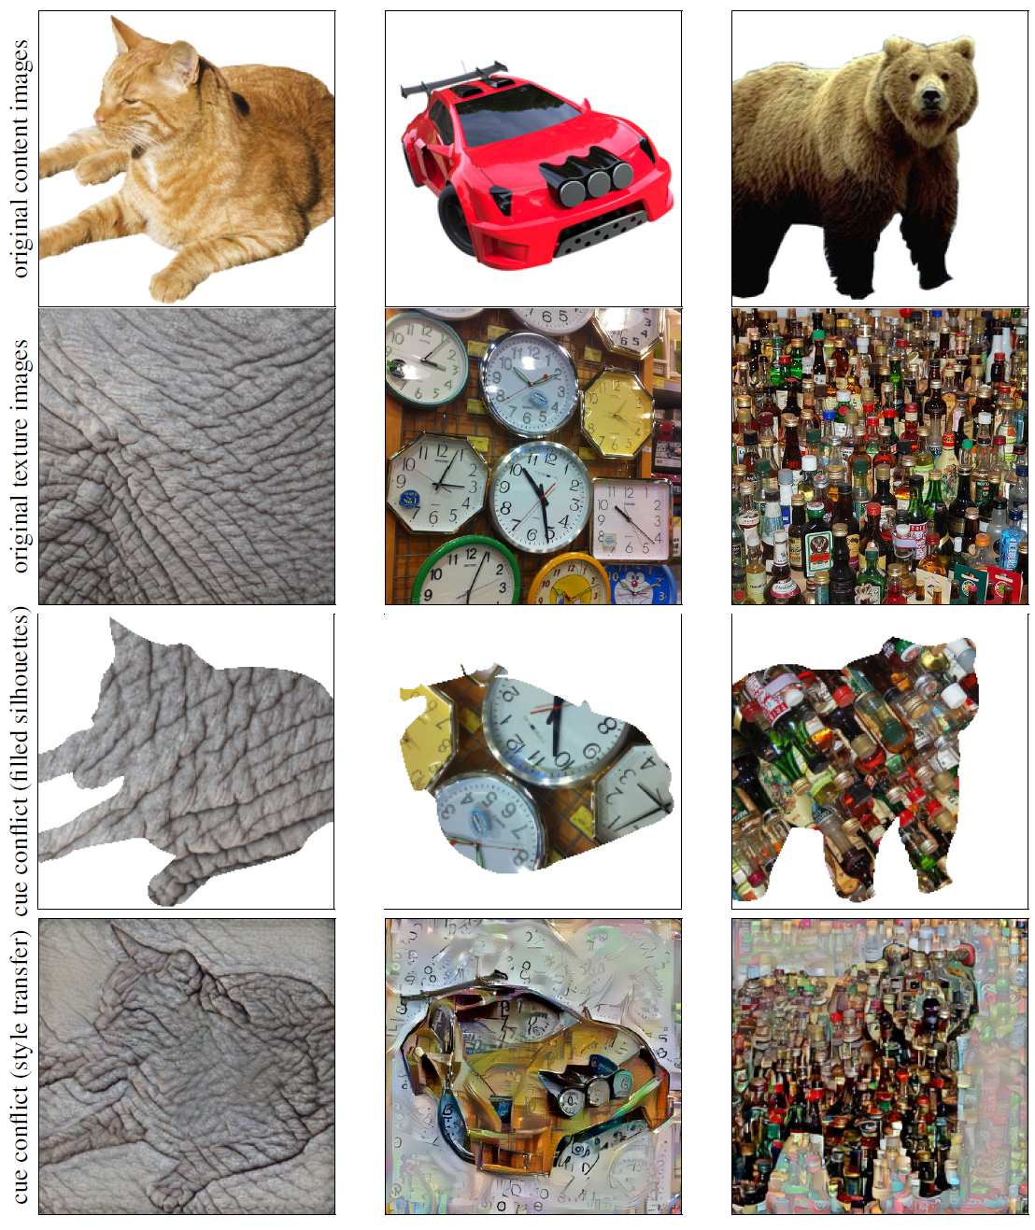

Slide 3
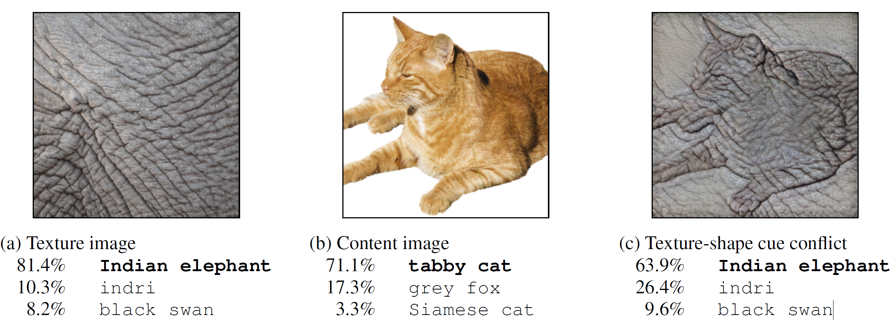
Background
Texture vs. shape?
Human vs. computer?
CNN are biased about texture, increasing shape bias improves accuracy and robustness.
ImageNet-trained CNNs are biased towards texture; increasing shape bias improves accuracy and robustness, ICLR 2019

Slide 4
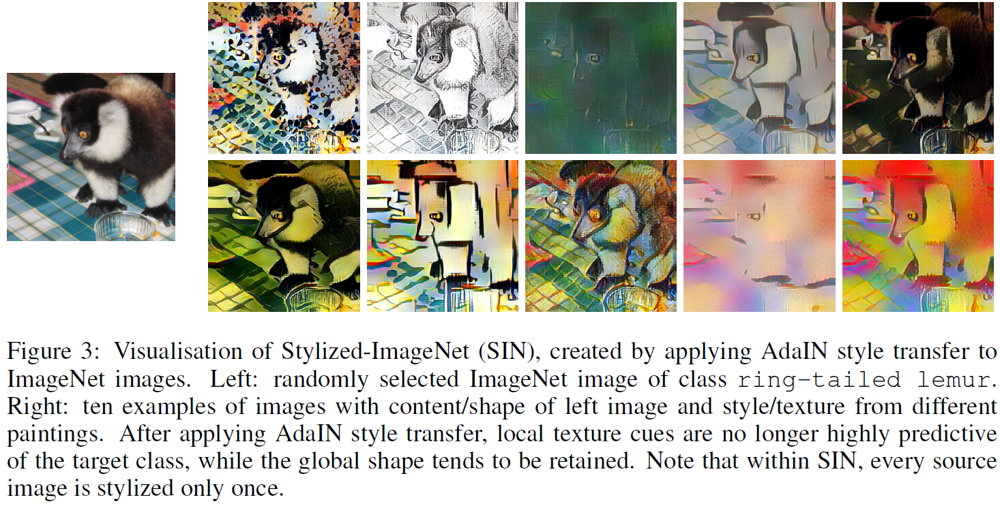
Create a new dataset: stylized-ImageNet (SIN)

Slide 5
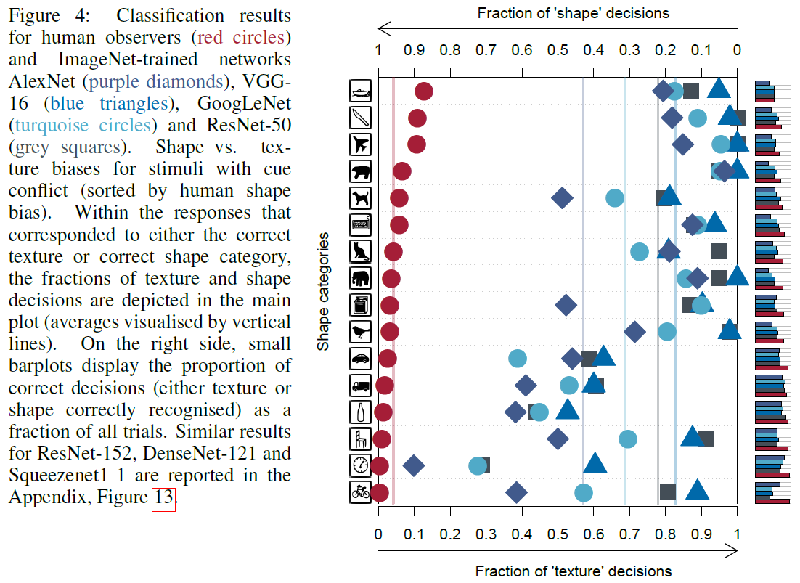

Slide 6
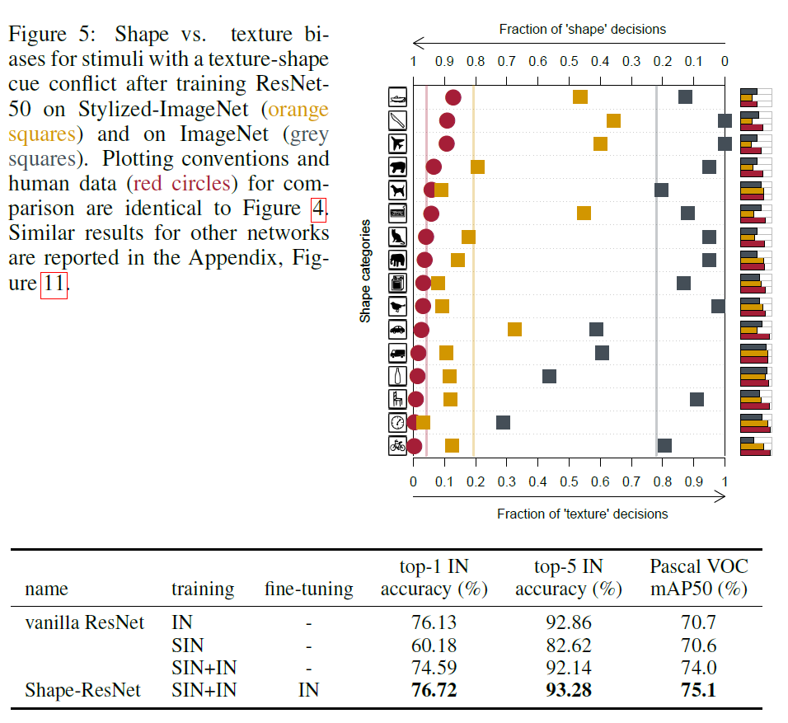

Slide 7
Proposed method
Previous algorithm
Change the style from outside dataset, label is remained.
IN --> texture basis
SIN --> shape basis
This paper
The biased feature representation of CNN mainly comes from the dataset.
Can we use single dataset to de-bias the texture and shape?

Slide 8
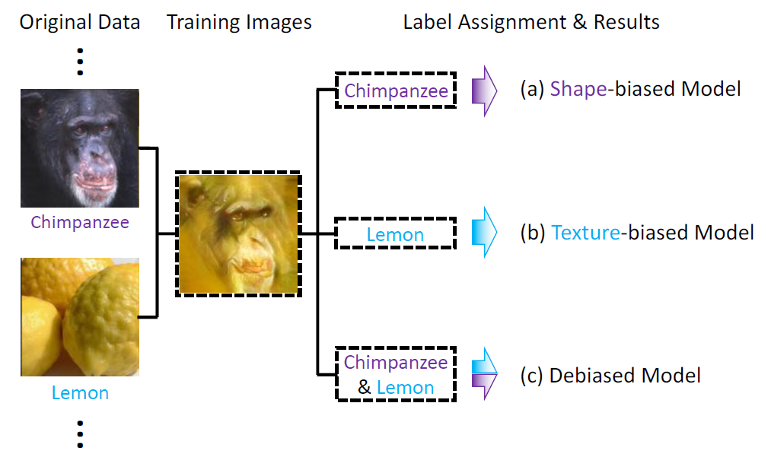
Data generation: from same dataset, two images for content and style.
???

Slide 9
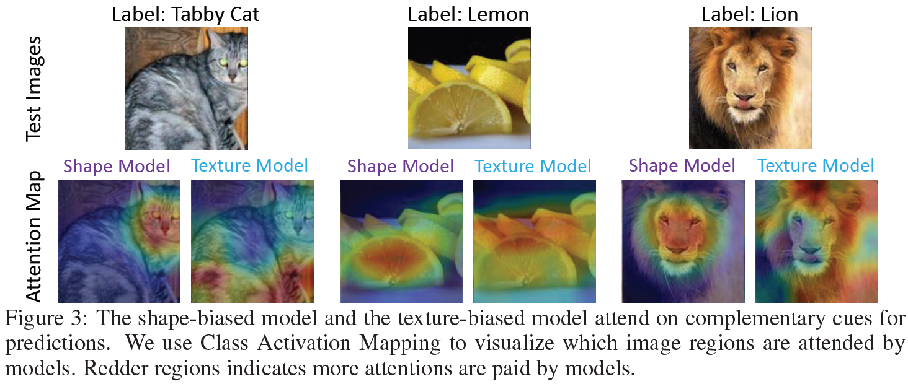
Visualize the two biased models for same images

Slide 10
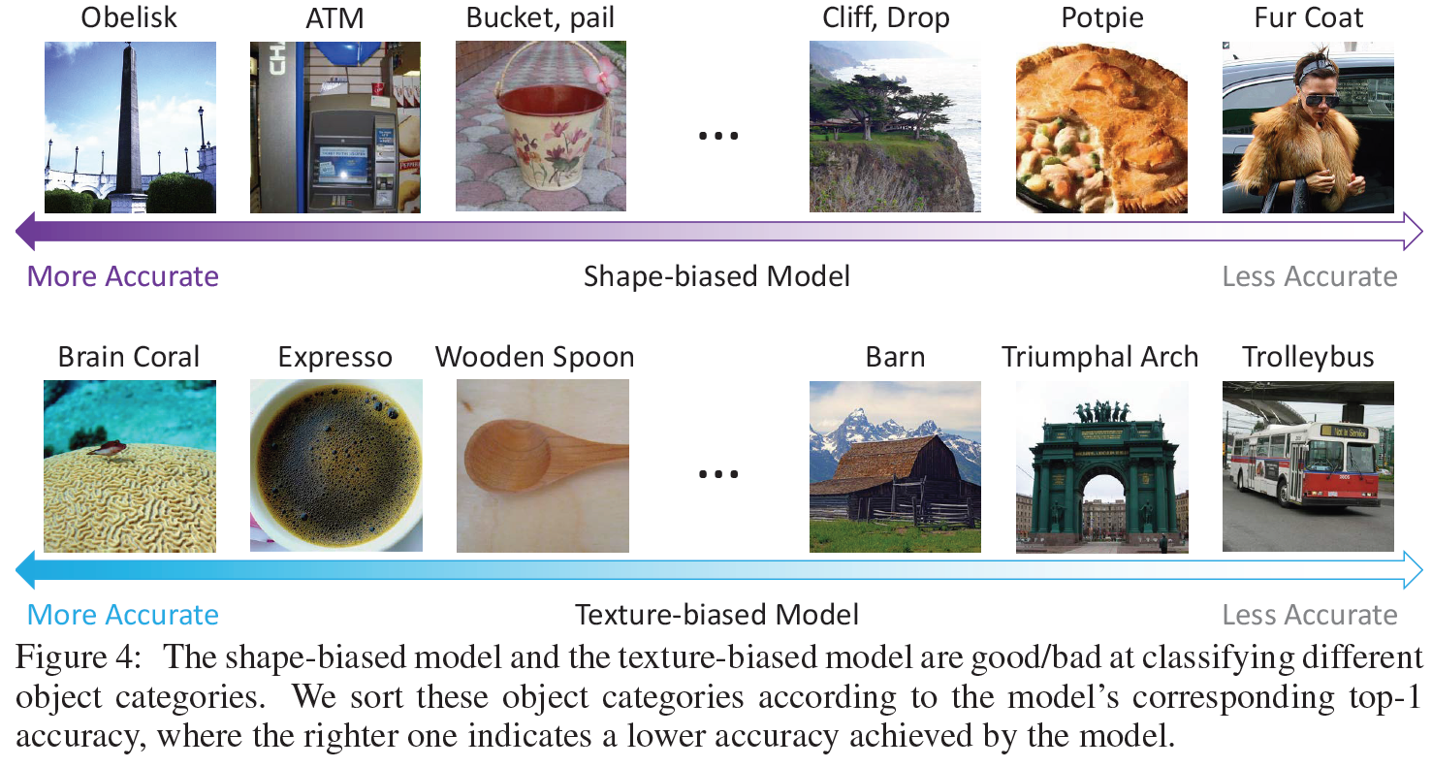
Visualize the two models in different classes

Slide 11
We should train models to acquire both shape and texture feature representations
???

Slide 12
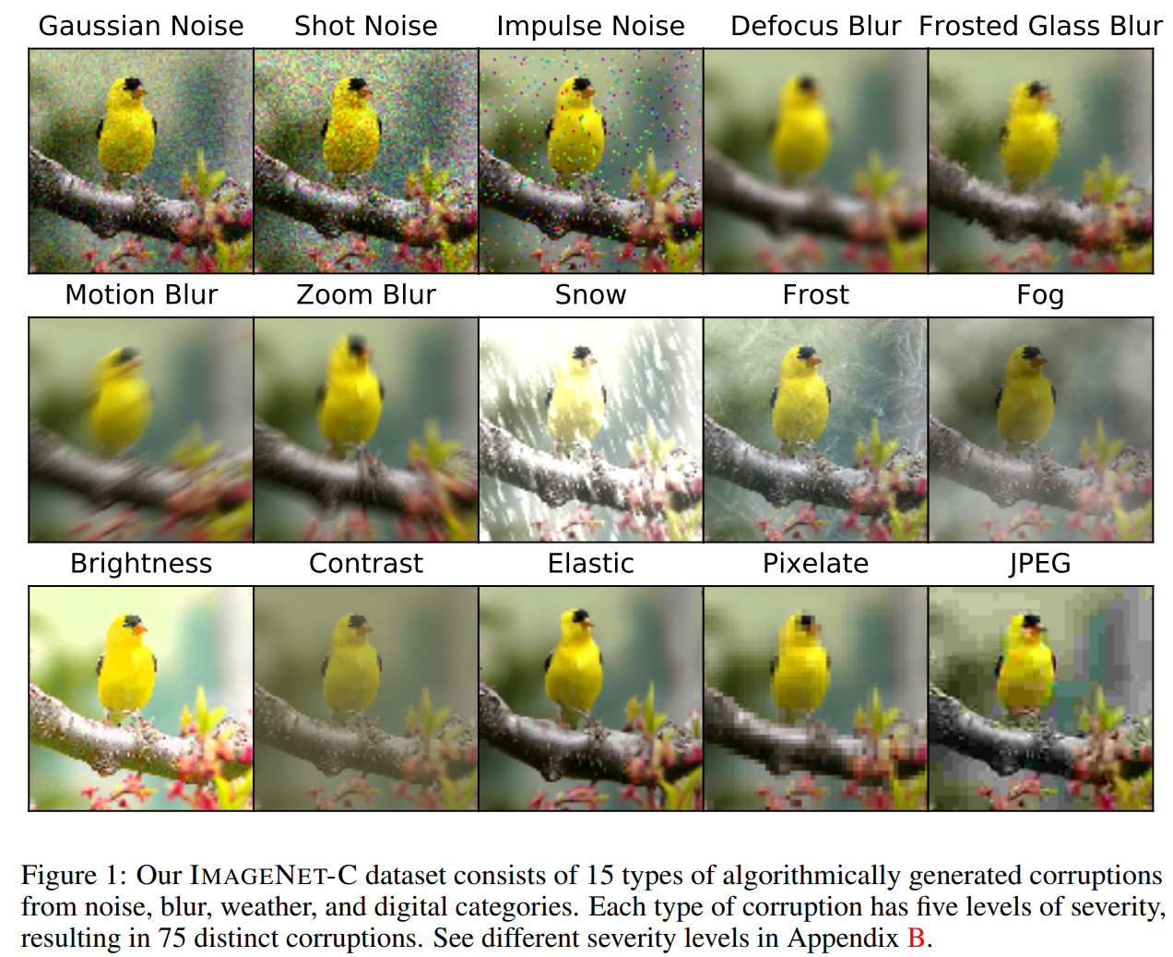
Experiments
Dataset: ImageNet-C
Benchmarking neural network robustness to common corruptions and perturbations, 2019 ICLR

Slide 13
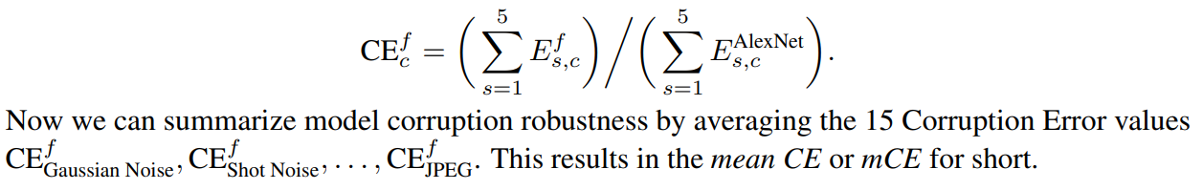
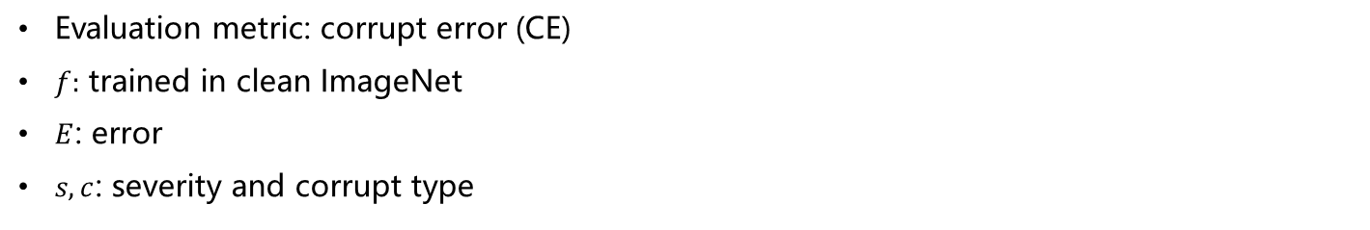
Evaluation metric: corrupt error (CE)
$f:$ trained in clean ImageNet
$E$: error
$s,c$: severity and corrupt type

Slide 14
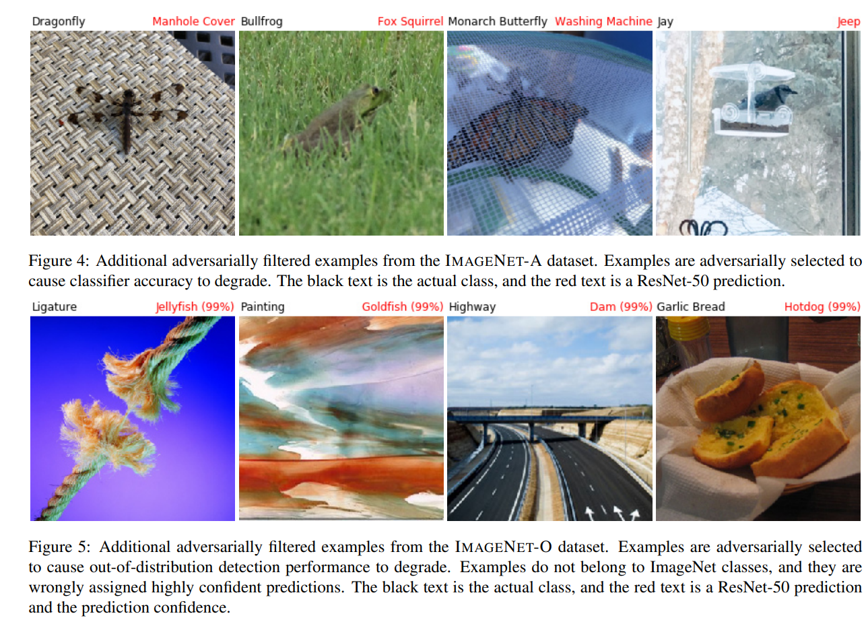
Dataset: ImageNet-A
Natural Adversarial Examples, CVPR 2021

Slide 15
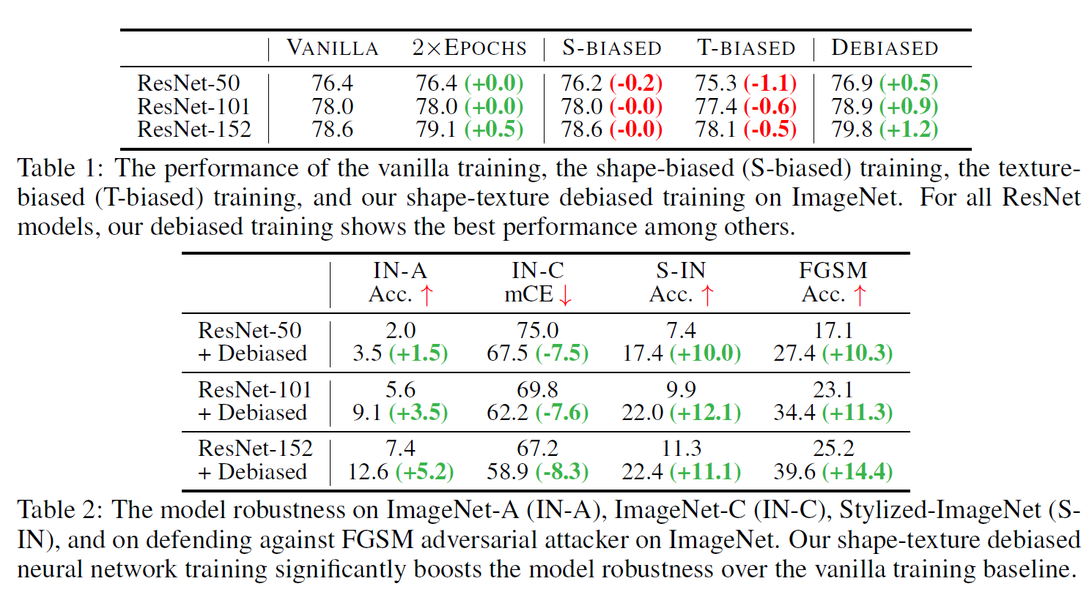
Other datasets: ImageNet (IN), Style ImageNet (SIN), FGSM (adversarial)
Results

Slide 16
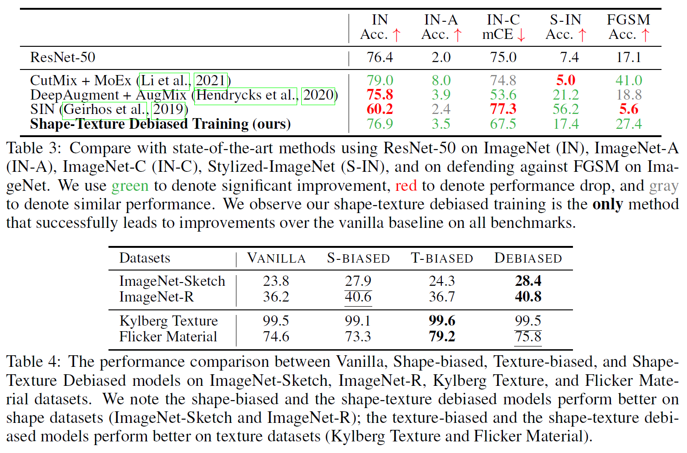

Slide 17
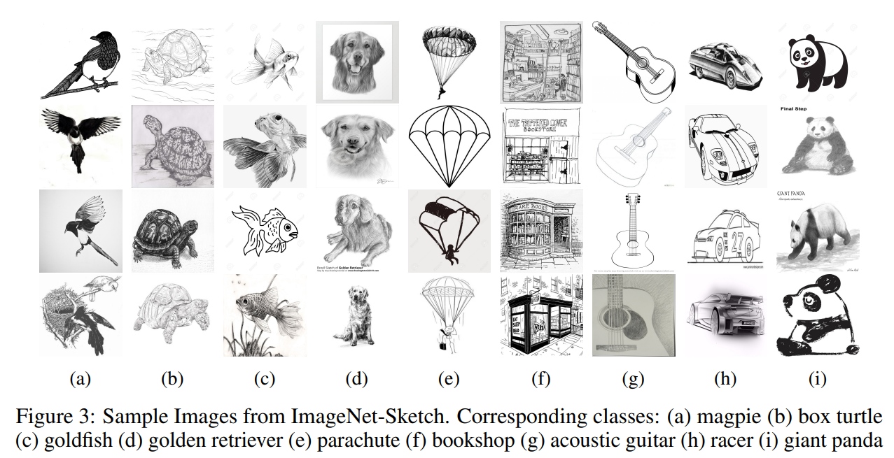
Learning Robust Global Representations by Penalizing Local Predictive Power, 2019 NIPS

Slide 18
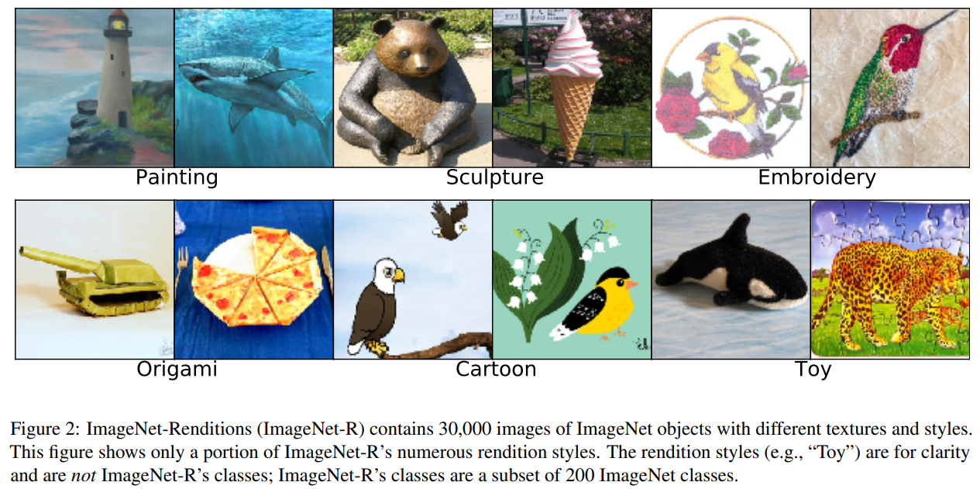
The Many Faces of Robustness: A Critical Analysis of Out-of-Distribution Generalization, ICCV 2021

Slide 19
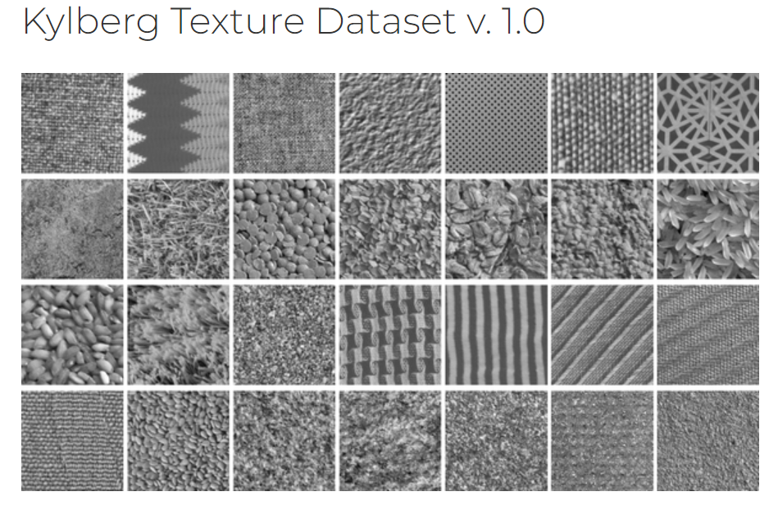

Slide 20
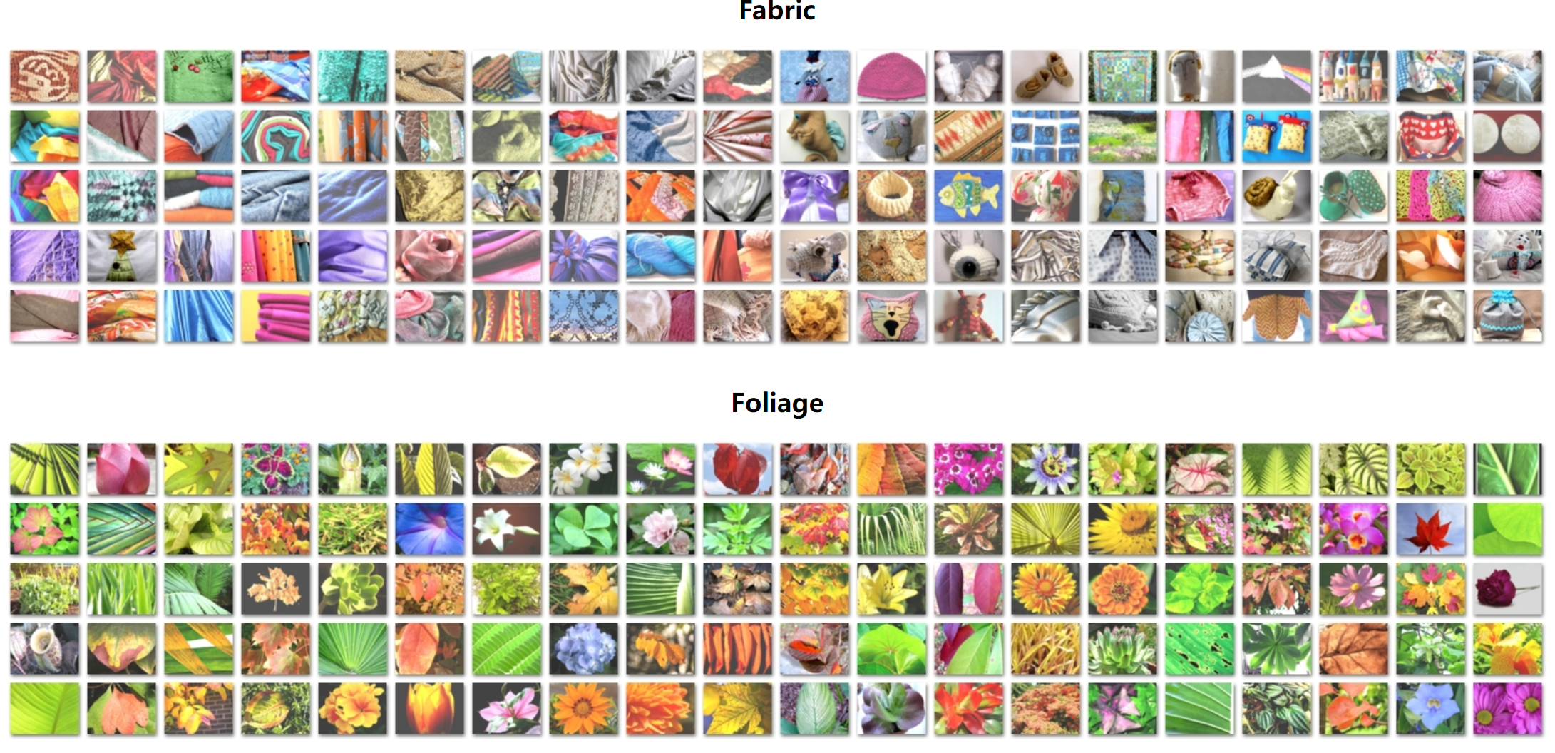
https://people.csail.mit.edu/celiu/CVPR2010/FMD/

Slide 21
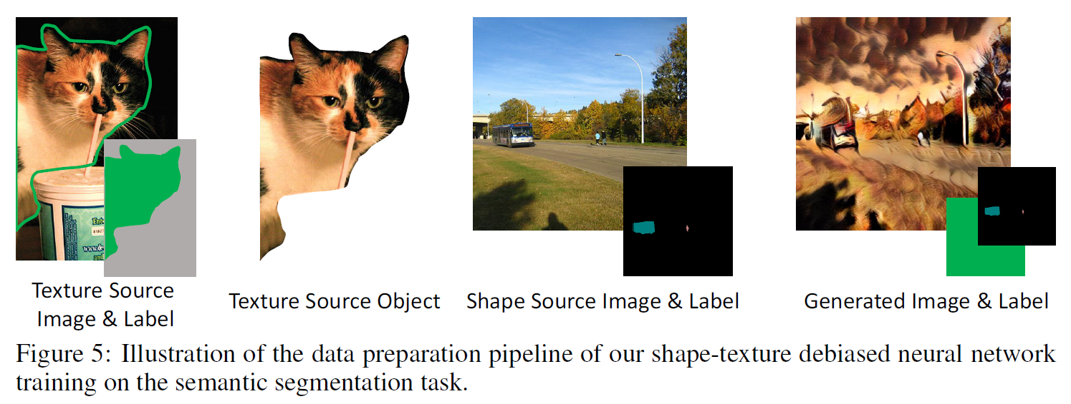
On semantic segmentation
DeepLabv3-ResNet-101: 77.6% mIoU, increase by 1.1%

Slide 22
Conclusion
Conclusion:
Train with changed dataset,
Also supervised on the changed dataset, instead of the original one.
My thinking
We should pay more attention to our dataset of application
The character of our dataset

